Slide 1
Installation Guide
(Eclipse Plug-in － Properties Editor 5.3.3
on Eclipse 3.5)
2009. 07. 20
CODELABOR
Shin Sang Jae (codelabor@gmail.com)

Slide 2
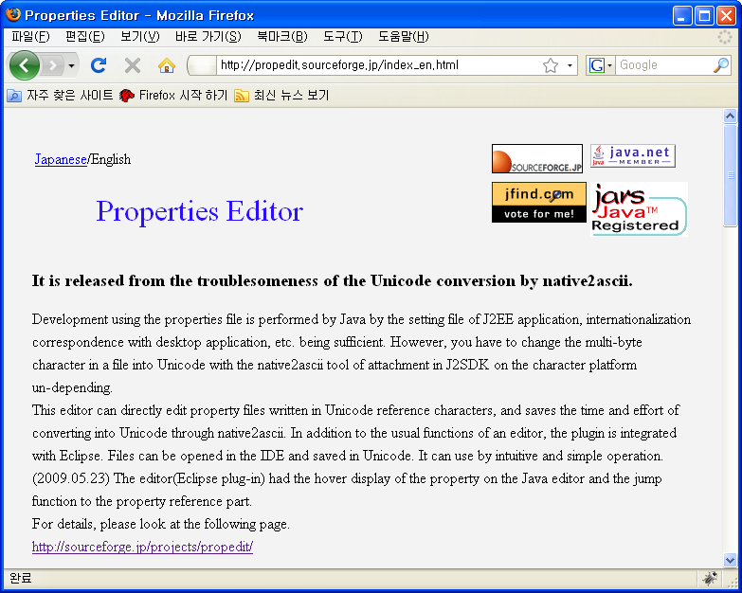
Properties Editor
Site
Eclipse Properties plug-in
Official Site URL: http://propedit.sourceforge.jp/

Slide 3
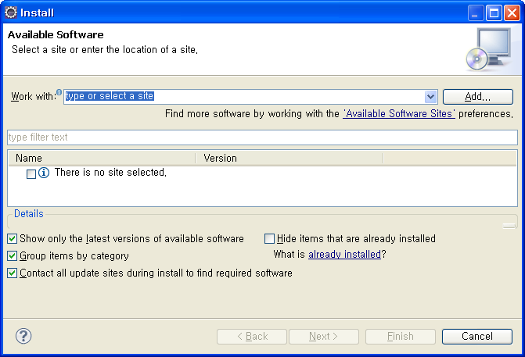
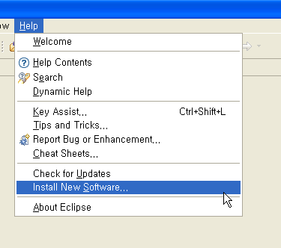
Properties Editor
Install
Menu
  Help > Install New Software...
Install Window
  Work With: > Add

Slide 4
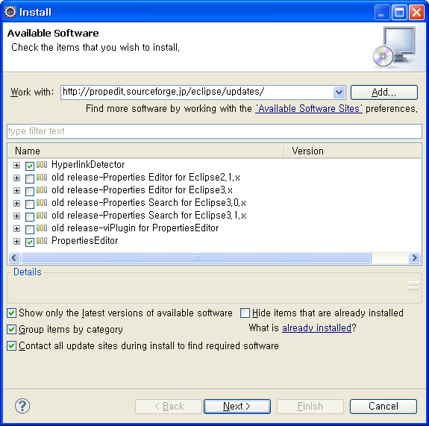
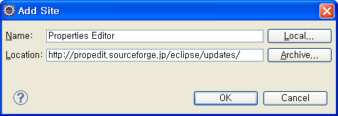
Properties Editor
Add Site
Add Site Windows
  Name: Properties Editor
  Location: http://propedit.sourceforge.jp/eclipse/updates/
  Check HyperlinkDetector
  Check PropertiesEditor

Slide 5
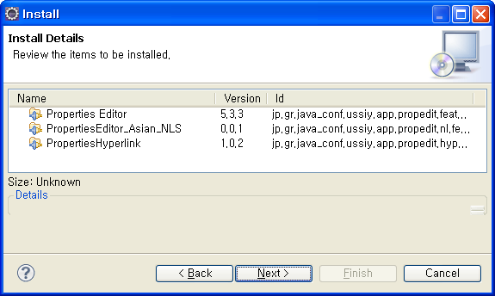
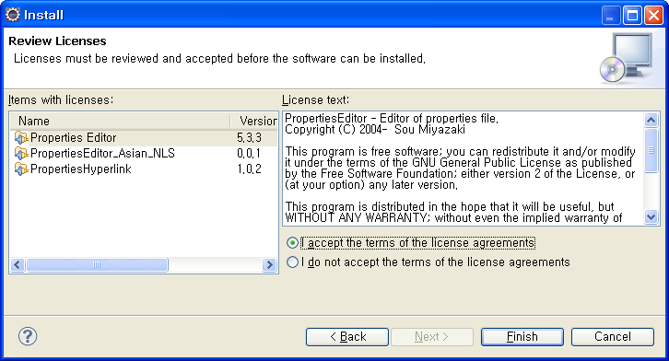
Properties Editor
Install
Install Details Window
Accept the terms of the license agreements

Slide 6
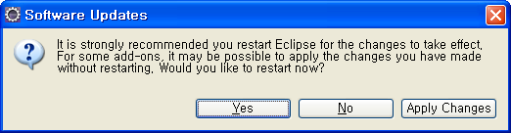
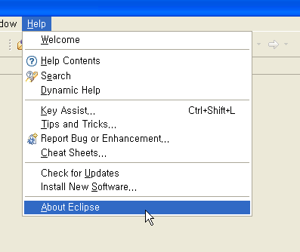
Properties Editor
Software Updates
Software Updates Window
  Restart
Menu
  Help > About Eclipse

Slide 7
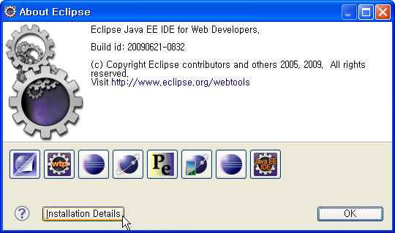
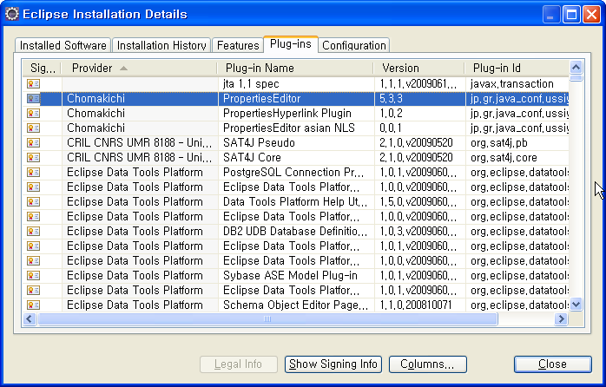
Properties Editor
Software Updates
About Eclipse Window
  Install Details
Eclipse Installation Details Window
  Plug-ins

